Slide 1

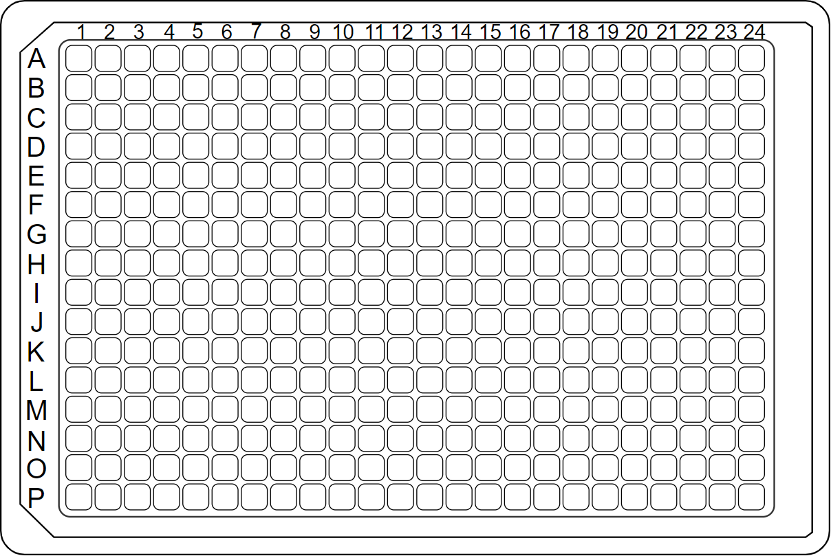
KCGS 2.0 Plate Map 2023
AKI-013a
UNC-NK-400
AKI-008a
AKI-026a
UNC-NK-176
MLi-2 (MRKI-15)
PFE-PKIS 39
CA93
GW560459
GSK2292767
XMD-17-51
GW632580X
D2202-1
GSK114
AKI-001a
UNC-YL-291
GW855857
XMD8-87
GW770249A
AKI-053a
AKI-018a
MRKI-10
GSK2336394
GW276655
GW440135
CCT251545
GW651576X
TPKI-106
TPKI-24
AKI-014a
MRKI-06
ESD0001929
SGC-STK17B-1
GSK1122999
GW513184X
GR269666A
GW282449A
GSK2606414
AKI-034a
ESD0001947 (BAY-265
MRKI-22
AKI-046a
ESD0001931
PA-16-0081C
UNC-NK-176
PFE-PKIS 1
DDR1-in-1
VE-822
SB-216385
GSK1379761
SB-708998
TPKI-58
GW792479
TPKI-16
GSK237701A
GSK2298859
GSK481
AKI-065a
UNC-AP-49
AKI-071a
UNC-AP-46
UNC-YL-295
MRKI-05
GSK2297428
BI00604564
SB-590885
WZ4003
PFE-PKIS 25
SB-633825
BI01125081
PFE-PKIS 32
GW684088
PFE-PKIS 29
MRKI-30
BIRZ0518XX
GSK1392956A
AKI-004a
UNC-NK-405
AKI-007a
AKI-023a
UNC-NK-406
AKI-012a
TRO-SGC-005
GW406108X
CCT244747
CCT251921
PFE-PKIS 44
GSK190937
GSK2269557
GW811761X
GW780159X
FM-381
BI00614644
GW683134A
AKI-050a
AKI-017a
ESD0001938 (BAY-866
MRKI-15 (MLi-2)
AKI-025a
GW300660X
GW868318
GSK461364
GSK300657X
GW440146
GSK949675
BI00009348
GW525701
GSK872
SB-517081
GSK2219385
GSK843
UNC-AP-78
UNC-CAF-158
ESD0001918
MRKI-24
AKI-045a
ESD0001923
UNC-CAF-204
AKI-055a
TRO-SGC-010
ERK5-IN-1
GW572399X
NVP-2
BMX-IN-1
NVS-PAK1-1
GSK299115A
TPKI-105
SB-735464
GSK2334470
SB-733894
GSK1379710
BI00036838
MRKI-35
AKI-070a
AKI-074a
XMD8-92
GSK336313
GSK583
BI00801818
VE-821
GW305074X
TPKI-69
GSK204919
UNC-NK-397
UNC-AP-80
UNC-CAF-187
UNC-YL-294
SB-693162
GW814408X
GW576924A
GSK1379712
UNC-AP-35
AKI-006a
AKI-021a
UNC-AP-307
AKI-011a
AKI-047a
TRO-SGC-013
GW867253
GSK2283293
GW335962X
BI00113608
GW621970X
BI00007366
GW784752X
TH257
BI00047804
GW642138X
GSK1070916
ESD0001945 (BAY-320
MRKI-02
AKI-024a
SB-725317
THZ1
GSK840
UNC-AP-80
AKI-016a
ESD0001922
SGC-CK2-1
GW416981X
PFE-PKIS 21
GW429374A
GSK2376236
GSK1398477
GW580509X
GSK1838705
BIBF0846CL
SB-710397
MRKI-20
AKI-042a
ESD0001937 (BAY-438
MRKI-28
AKI-049a
UNC-NK-283
TRO-SGC-011
GW810372X
GSK200398A
BIBW3133BS
GSK2328680
BI00645435
SGC-AAK1-1
SB-282975
GSK2578215
TPKI-100
GW296115X
PFE-PKIS 3
SB-732932
UNC-CAF-061
AKI-067a
UNC-AP-32
UNC-CAF-080
AKI-073a
UNC-NK-281
SGC-CAMKK2-1
GSK312879
TPKI-85
HG-10-102-01
HTH-01-015
GSK2850163
Vertex 11e
TPKI-39
GW282974X
BI00865461
GSK223675
GW435821X
GW807982X
UNC-NK-260
AKI-009a
AKI-031a
TPKI-72
SB-219980
TPKI-91
BI00601000
THZ531
GW434756X
BI2536
AKI-005a
AKI-019a
UNC-NK-385
TRO-SGC-029
PFE-PKIS 40
GW569293E
GW578748X
AKI-015a
AKI-063a
MRKI-04
AKI-022a
ESD0001925
MRKI-12
DCLK1-IN-1
GSK2373690
PFE-PKIS 12
GW412617
GSK2656157
GSK1379762
GW442130X
GSK579289A
UNC-AA-1-0017
SB-742609
GSK2250882
GW709042A
GW830900A
MRKI-27
AKI-048a
H89
GNF-5
TPKI-97
JH-II-127
AH5015
K05908
SB-242719
SB-772077-B
AKI-041a
ESD0001941
ESD0001927
PA-16-0081B
GSK270822A
SB-747651A
GSK2288359
GW830263A
BIRB0876BS
JNK-IN-7
BI00133844
TX-85-1
PFE-PKIS 41
PFE-PKIS 34
TPKI-26
AKI-066a
UNC-AP-37
UNC-CAF-143
AKI-072a
UNC-AP-80
UNC-CAF-061
SGC-CLK-1
GSK204607
CCT241533
GW280670X
GSK1904529
GW693917A
GW832467X

